Slide 1
MANUFACTURING TECHNOLOGY-I
[ME6302]
III SEMESTER / II YEAR – ‘A’ SECTION
MECHANICAL ENGINEERING
[Academic Year: 2015-2016 – Batch: 2014-2018]
]

Slide 2
‘Manufacturing’ is derived from the Latin,
manus = hand and factus = made,
that is, the literal meaning is “made by hand”.
‘Manufacturing’ means the making of goods and articles by hand and/or by machinery.
‘Manufacturing Technology’ or “Production Technology” can be defined as the study of the various processes required to produce parts and to assemble them into machines and mechanisms.

Slide 3
SAND CASTING
Sand moulds
Type of patterns
– Pattern materials
– Pattern allowances
Moulding sand
– Types
– Properties
– Testing
Core making
– Types
– Applications
Moulding machines
– Types
– Application
MELTING FURNACES
  – Blast
  – Cupola
SPECIAL CASTING PROCESSES
– Shell
– investment casting
– Ceramic mould
– Lost Wax process
– Pressure die casting
– Centrifugal casting
– CO2 process
– Stir Casting
(Working principle)
DEFECTS IN SAND CASTING

Slide 4
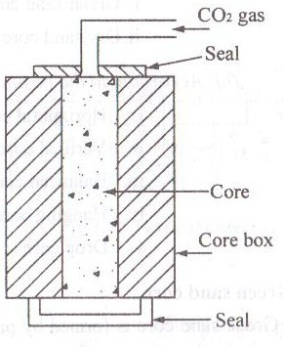
Cold curing CO₂ Process
To make good Quality castings in large numbers.
Binder – Pure dry silica sand + Sodium silicate liquid
Moisture content – Should not exceed 3 %
Additives – Sawdust about 1.5%, Asbestos powder – up to 5%, Graphite powder – deformable & collapsible

Slide 5
CO₂ gas is passed through the core for 30 sec at 140 KN/m².
CO₂ + Sodium silicate = Sodium carbonate + Silica jell
Silica jell binds the sand.

Slide 6
(MOULDING) SAND TESTING METHODS
Moisture content test
Clay content test
Grain fitness test
Permeability test
Strength test
Deformation or Toughness test
Hot strength test
Refractoriness test
Mould hardness test

Slide 7
(CORE) SAND TESTING METHODS
Green strength test
Baked strength test
Retained strength test
Core strength test
Moisture content test

Slide 8
MOULDING
Moulding is the process of making a mould cavity by packing prepared moulding sand around the pattern and removing the pattern from the mould to form the mould cavity.
Types:
Green sand mould
Dry sand mould
Loam sand mould

Slide 9
MOULDING METHODS
Bench Moulding
Floor Moulding
Pit Moulding
Sweep Moulding
Plate Moulding

Slide 10
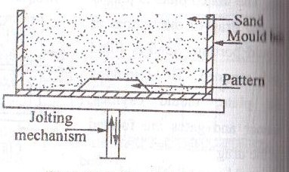
JOLTING MACHINE

Slide 11
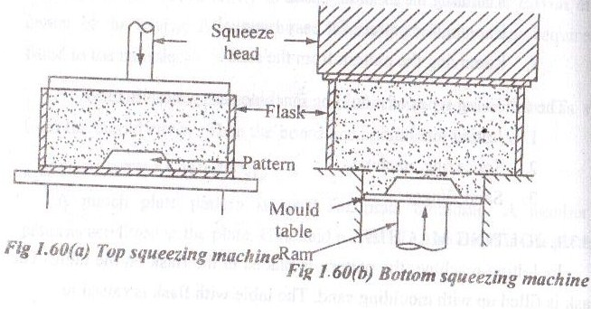
SQUEEZING MACHINE

Slide 12
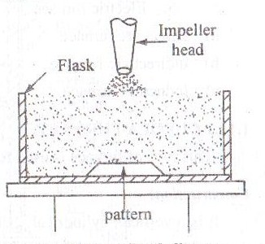
SAND SLINGER

Slide 13
MELTING FURNACE
Cupola – CI
Open hearth – Steel
Crucible – Non-Ferrous
  Pit type
  Coke fired stationary
  Oil fired tilting
4. Pot
5. Electric
  Direct arc
  Indirect arc
  Induction

Slide 14
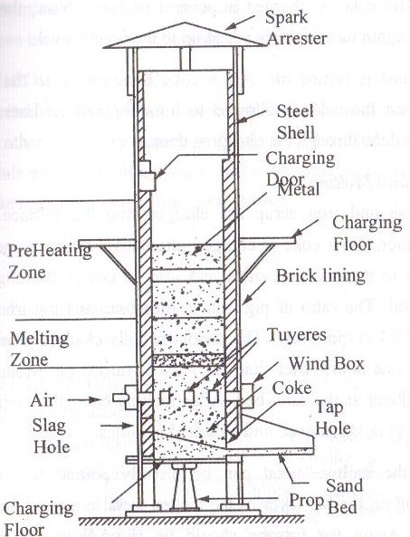
CUPOLA FURNACE

Slide 15
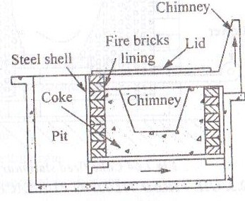
CRUCIBLE - PIT FURNACE

Slide 16
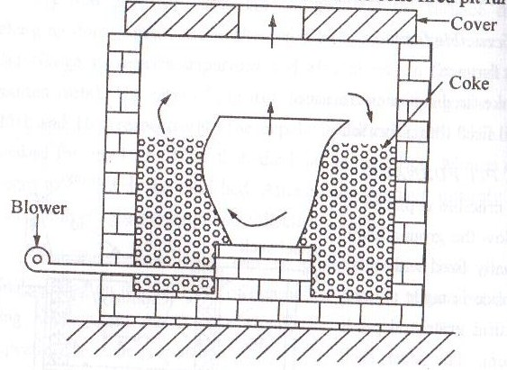
CRUCIBLE - CFS FURNACE

Slide 17
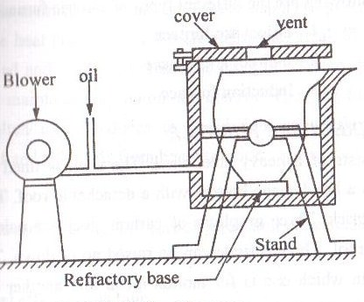
CRUCIBLE - OFT FURNACE

Slide 18
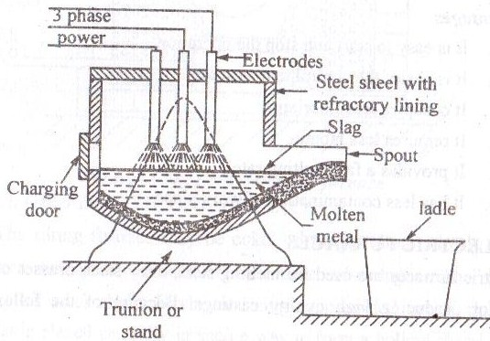
ELECTRIC – DA FURNACE

Slide 19
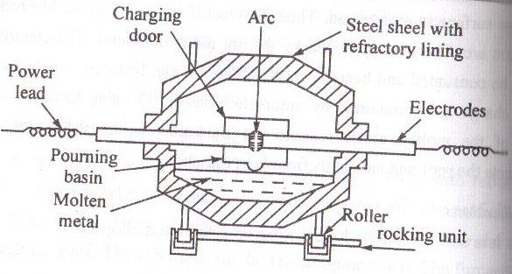
ELECTRIC – IDA FURNACE

Slide 20
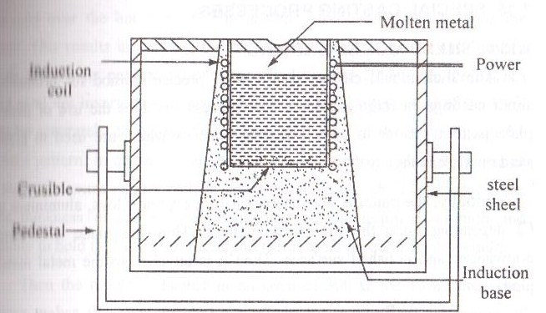
INDUCTION FURNACE

Slide 21
SPECIAL CASTING PROCESSES
Shell Mould Casting
Investment Casting
Ceramic Mould Casting
Lost Wax Process

Slide 22
5. Pressure Die Casting
  Hot chamber Die Casting
  Cold chamber Die Casting
6. Gravity Die Casting
7. Centrifugal Casting
8. Continuous Casting process

Slide 23
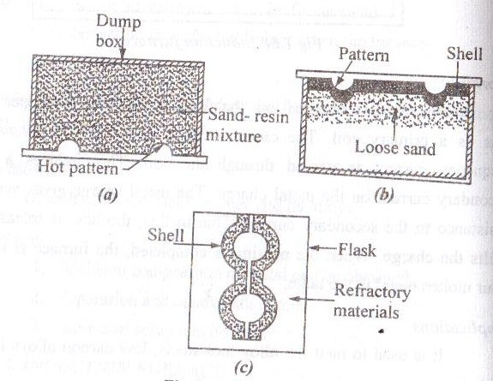
SHELL MOULD CASTING

Slide 24
5 to 10% - Phenolic resin mixed with fine dry silica
(Mixer – dry oil or presence of alcohol)
No water
230 – 600◦C
Release Agent – Silicone (sprayed over pattern)
Thickness of shell – time of contact of the mixture with the heated pattern (Ex: 20-30 sec, 6 mm)
Then the mould is heated in an Oven at 300◦C for 15-60 sec.
After cooling &Solidification, the shells are broken or shaken away from the castings.
Brake drums, Bushings, Cams, Cam shaft, rollers etc.,

Slide 25
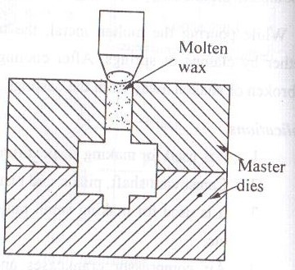
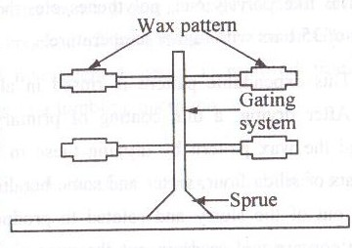
INVESTMENT CASTING

Slide 26
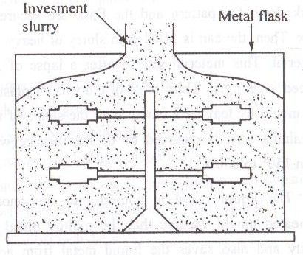
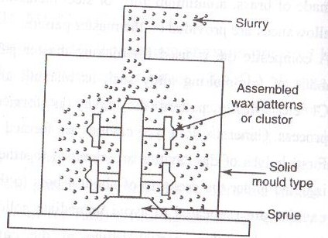

Slide 27
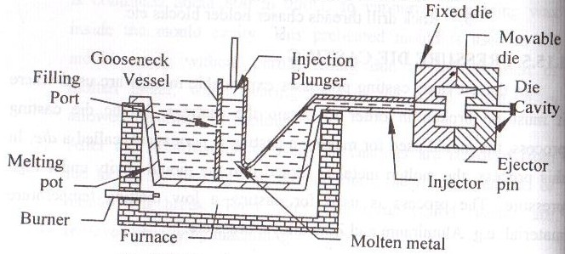
PRESSURE DIE CASTING
  PDC - HOT CHAMBER

Slide 28
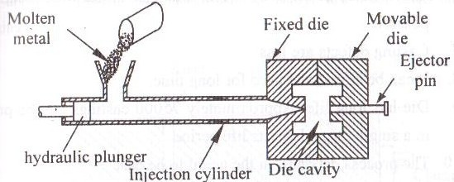
PDC - COLD CHAMBER

Slide 29
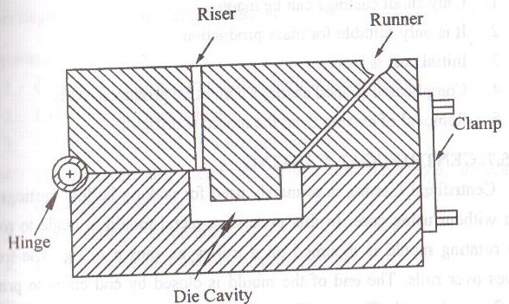
GRAVITY DIE CASTING
(Permanent mold casting)

Slide 30
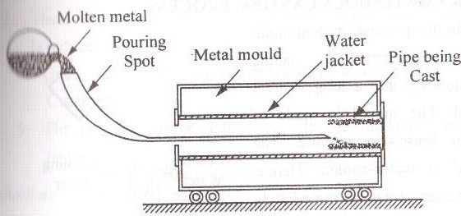
CENTRIFUGAL CASTING

Slide 31
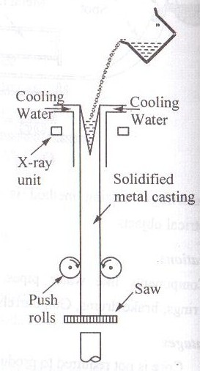
CONTINUOUS CASTING PROCESS

Slide 32
OTHER CASTING METHODS
LOST WAX PROCESS
CERAMIC MOULD CASTING

Slide 33
DEFECTS
Shrinkage
Blow holes
Scab
Swell
Hard Spots
Run out
Honey combing
Cracks
9. Shift
10. Cold Shut
11. Inclusions
12. Fins
13. Dress
14. Rat tail
15. Blister

Slide 34
INSPECTION METHODS
Visual Inspection
Pressure Test
Magnetic Particle Inspection
Dye-Penetrant Inspection
Radiographic Inspection
Ultrasonic Inspection
Thermography Inspection

Slide 35
Queries………..?

Slide 36
(QB) ASSIGNMENT - I
Two Marks
What are the different types of patterns used in foundry?
Define: Foundry, Casting, Mould, Pattern
Generally sweep patterns are used in _________ moulding.
What do you understand by core setting?
What is a core print? Mention its purpose.
Mention the specific advantages of CO₂ process?
What are the properties of good moulding and core sand.

Slide 37
7. Write the composition of good moulding sand
8. List out any five moulding tools.
9. What are chaplets?
10. List the factors to be considered in the choice of metal melting furnaces.
11. What are the types of alloys cast in cold chamber die casting machines?
12. What is the need for providing chills in casting?
13. Blow holes in castings occur due to ___________
14. How casting defects are identified?
15. Give any two casting defects and its reason and remedies.

Slide 38
16 marks
1. What are the pattern allowances? Explain briefly each.
2. Discuss the properties of moulding sand.
3. What are the different types of furnace used in foundry? Describe in detail with neat sketches any two of them.
4. State the different types of mould. Write a short notes on ‘Green sand Mould’ and ‘Shell moulding’.
5. Explain briefly the various moulding methods used in foundaries.
6. Describe the various types of casting process.

Slide 39
ASSIGNMENT – I
7. Explain various testing methods Moulding sand and Core sand.
8. Enumerate the various casting defects and suggest suitable remedies.
9. Explain various inspection methods of cast products.
5x2 = 10
3x16 = 48
58
Given Date: 07.08.2013 Last Date: 12.08.2013

